Slide 1

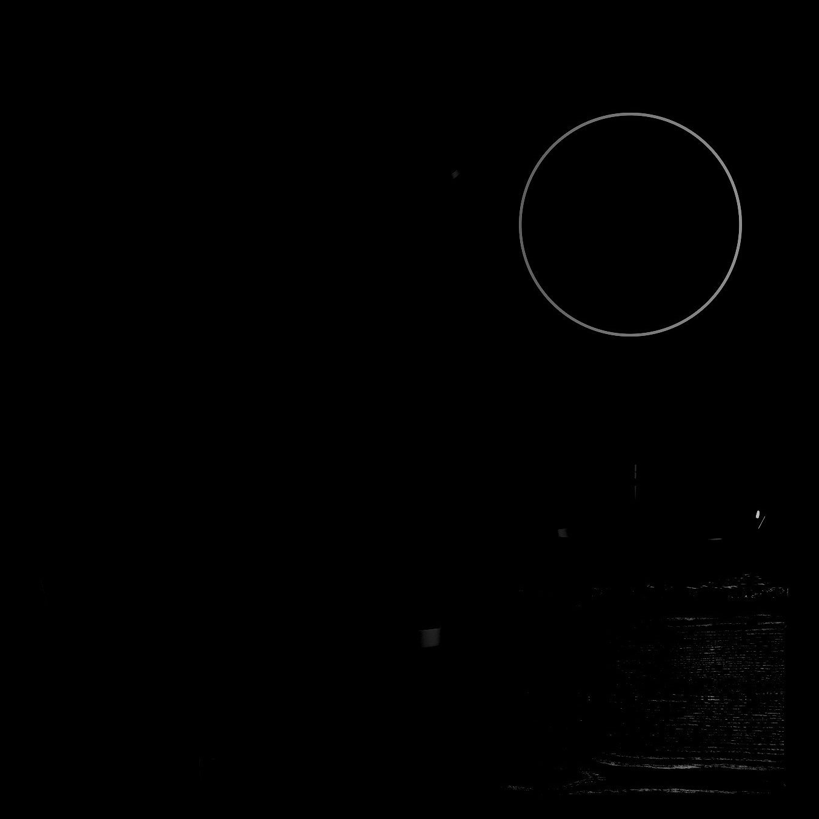



BLACK JACK GAME
GUIDE NAME -
Dr. Manickavasagam

Slide 2
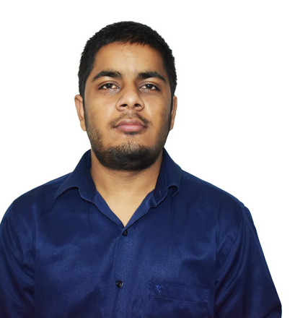
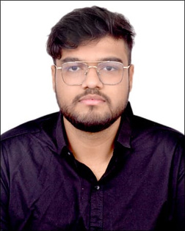
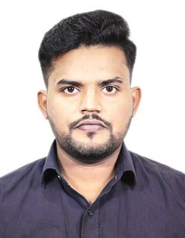
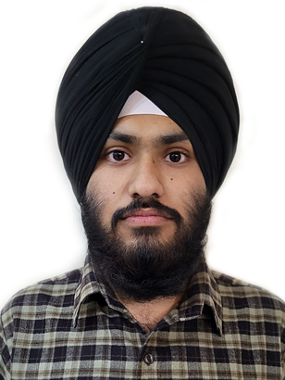
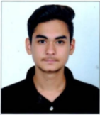

TEAM
MEMBERS:-
MANISH
20BCE10505
SHIVANSH SHUKLA
20BCE10559
PRINCE RANJAN
20BCE10560
SIMAR DHAMI
20BCE10626
DEVESH
20BCE10674

Slide 3

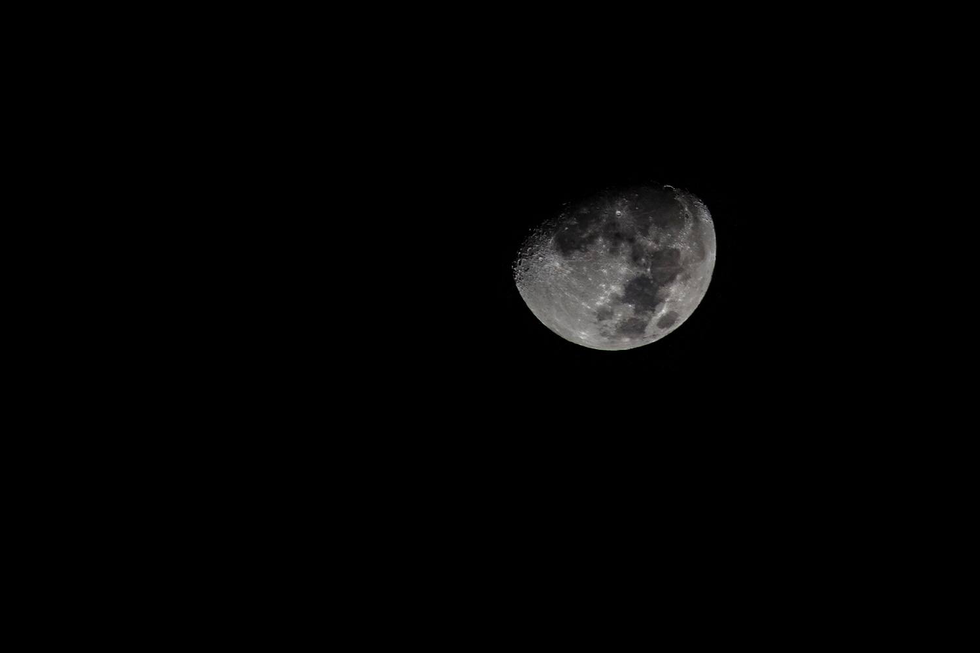
BRIEF OUTLINE
INTRODUCTION
OBJECTIVE
PROBLEM STATEMENT
LITERATURE REVIEW
PROPOSED WORK
REAL-TIME USAGE
OVERALL SYSTEM ARCHITECTURE DIAGRAM
RULES
MODULES SPLIT UP
HARDWARE AND SOFTWARE REQUIREMENTS
PROJECT TIMELINE CHART
CONCLUSION

Slide 4


INTRODUCTION
Black Jack , one of the most popular "CASINO GAMES", played among many people around the world and it's also treated as a part of rich lifestyle, and included as a activity in regular lifestyle. It uses decks of 52 cards and descends from a global family of casino banking games known as Twenty-One. This family of card games also includes the British game of Pontoon and the European game, So we are planning to make a virtual black jack terminal game.

Slide 5

OBJECTIVE
The objective is to create a virtual black jack casino terminal based game for people willing to play this game from their
respective places rather going out to casino.

Slide 6


PROBLEM STATEMENT
Not everyone can afford playing this game in casino as this is a game with high risks and huge amount requirements. But every one have a dream to play this game once, so to counter this, we have made our own game which could be played at home.
Also in some countries, people are not allowed at casinos to play this game. And casinos are not available everywhere, so this game is made so that it is available to all who wishes to play.

Slide 7


LITERATURE REVIEW
Black Jack game is most popular and likeable game and it's very famous among people. Going in casinos and have dream to live a rich lifestyle, but it needs requirement of money, time and casino around them. So we are planning to make a virtual casino terminal based game so, it will help people to play this game if casino is not near them and this will save their time, money and can be used for their entertainent purposes. And most impotantly is will reduce the addiction of people playing with real money.

Slide 8
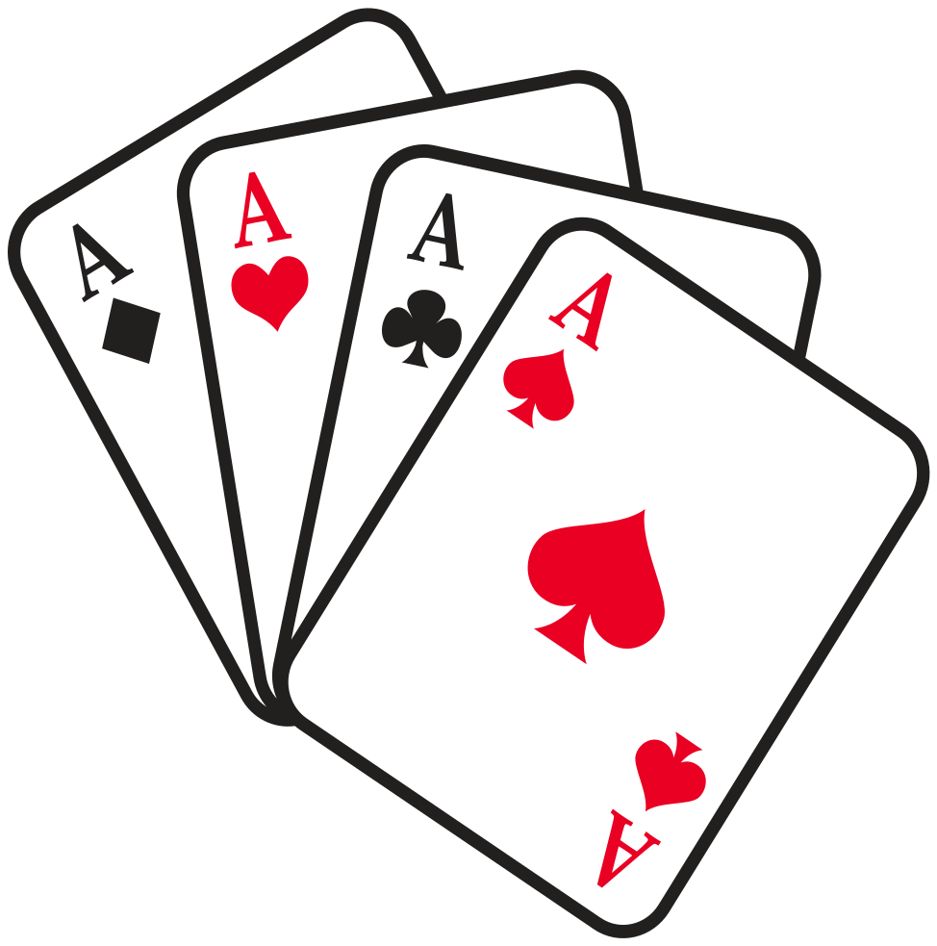
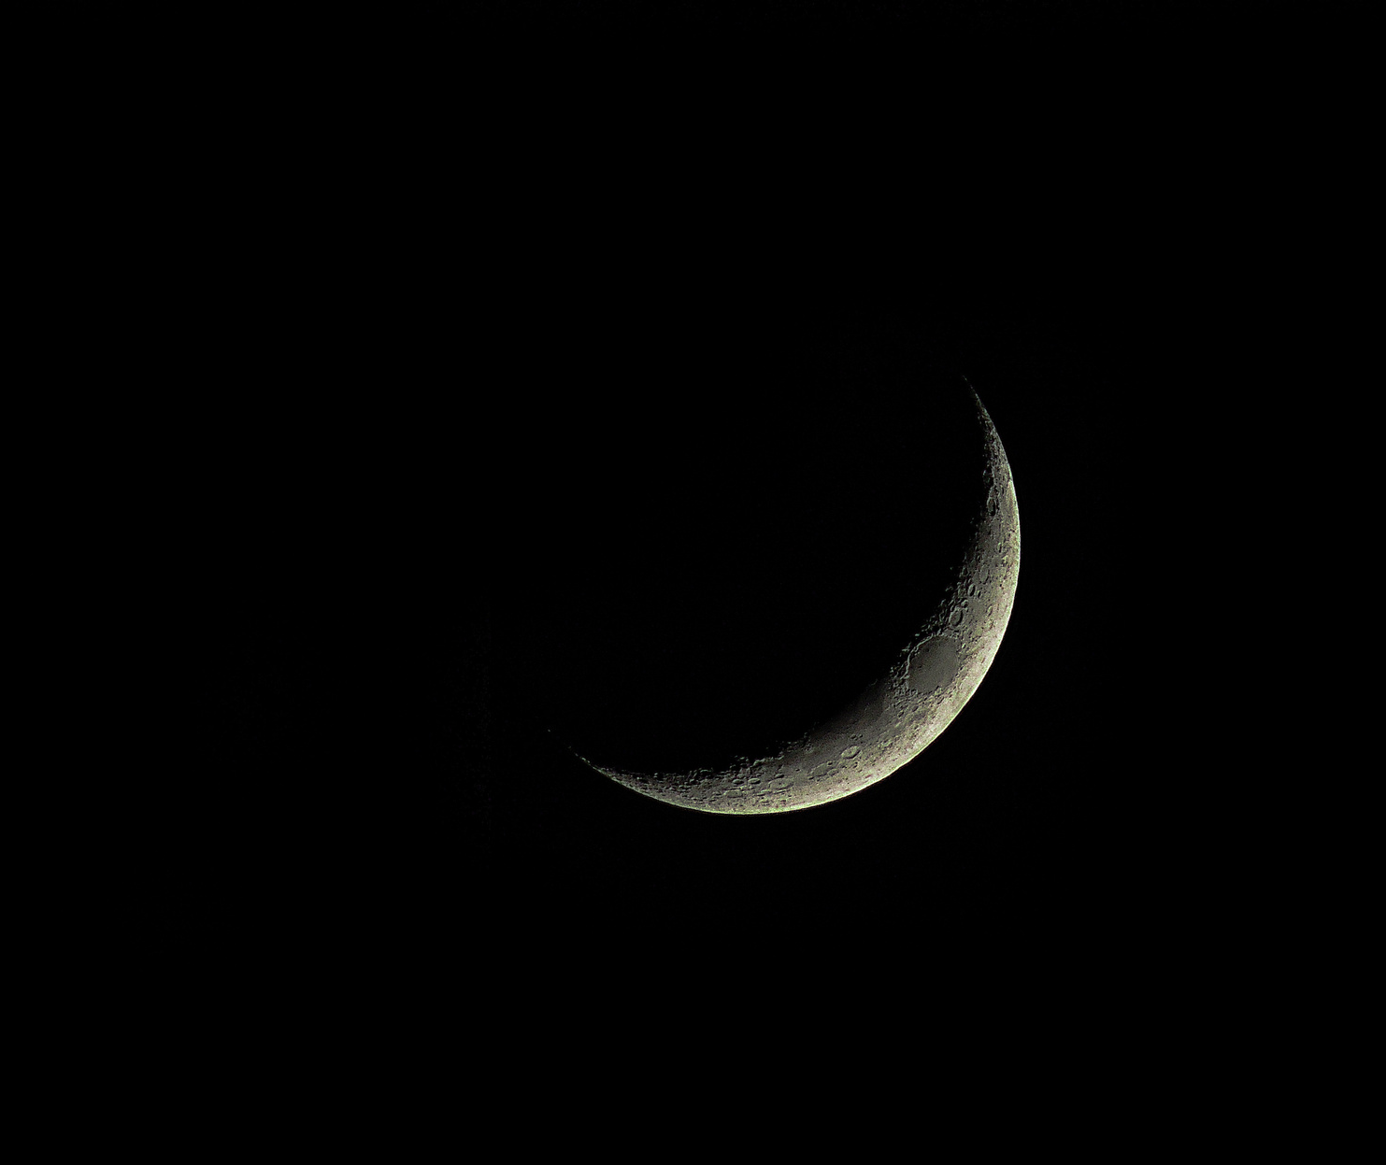


PROPOSED WORK
We are planning to write a java code to make a virtual casino terminal based black jack game for people, so they can enjoy their rich lifestyle sitting at their respective place and can save time and money. They can still enjoy their dream and play this high demands game without getting addicted to it.

Slide 9



REAL-TIME USAGE
In today's world, to play this popular game, people have to
search a casino near them and then has to wait for there chance to come and are required to have more time and money, searching a good casino around is one problem and another problem is managing time as well. As this game is already in
high demand, so people have to wait for a long time to get
their respective chances to play.
Also this game can be played at our home for entertainment
purposes with the family and friends.

Slide 10

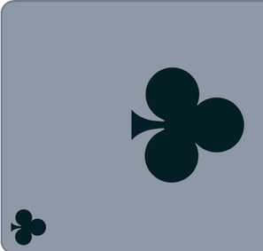
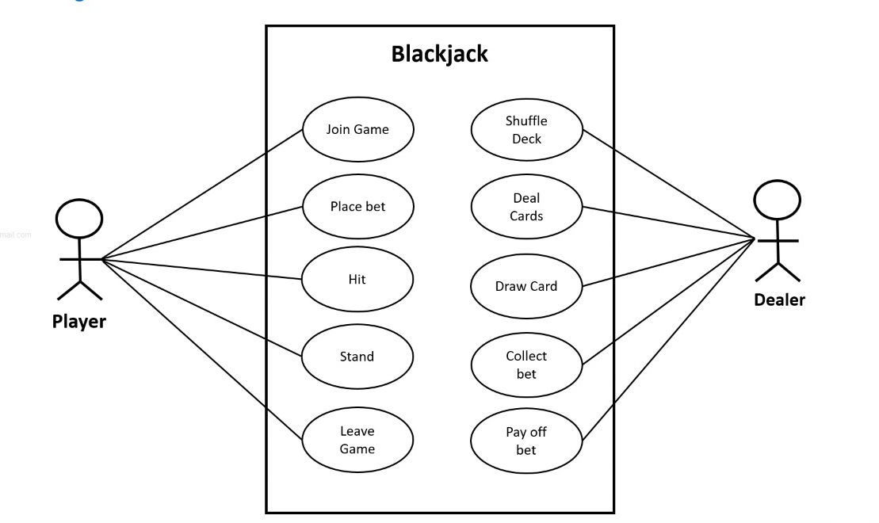
Overall System Architecture Diagram:
We are working on java code to create this
virtual casino black jack game.

Slide 11

RULES
- Each player is dealt 2 cards. The dealer is dealt 2 cards with one face-up and one face-down.
- Cards are equal to their value with face cards being 10 and an Ace being 1 or 11.
- The players cards are added up for their total.
- Players “Hit” to gain another card from the deck. Players “Stay” to keep their current card total.
- Dealer “Hits” until they equal or exceed 17.
- The goal is to have a higher card total than the dealer without going over 21.
- If the player total equals the dealer total, it is a “Push” and the hand ends.
- Players win their bet if they beat the dealer. Players win 1.5x their bet if they get “Blackjack” which is 21.

Slide 12

MODULE SPLIT UP:
S.NO
Modules
Duration
1
DISCUSSION
5 DAYS
2
IMPLEMENTATION
5 DAYS
3
EXECUTION
2 DAYS
4
PRESENTATION
3 DAYS
5
CODE IMPLEMENTATION
5 DAYS
6
REPORT
FUTURE WORK

Slide 13
HARDWARE AND SOFTWARE:
REQUIREMENTS:
HARDWARE
SOFTWARE
1: DESKTOP OR LAPTOP
2: KEYBOARD AND MOUSE.
1: ANY IDE.
2: JDK ENVIRONMENT.
OTHER REQUIREMENTS
1: BASIC UNDERSTANDING OF JAVA oops.
2: RECCOMENDED IDEs: INTELLIJ, ECLLIPSE, BLUEJ

Slide 14
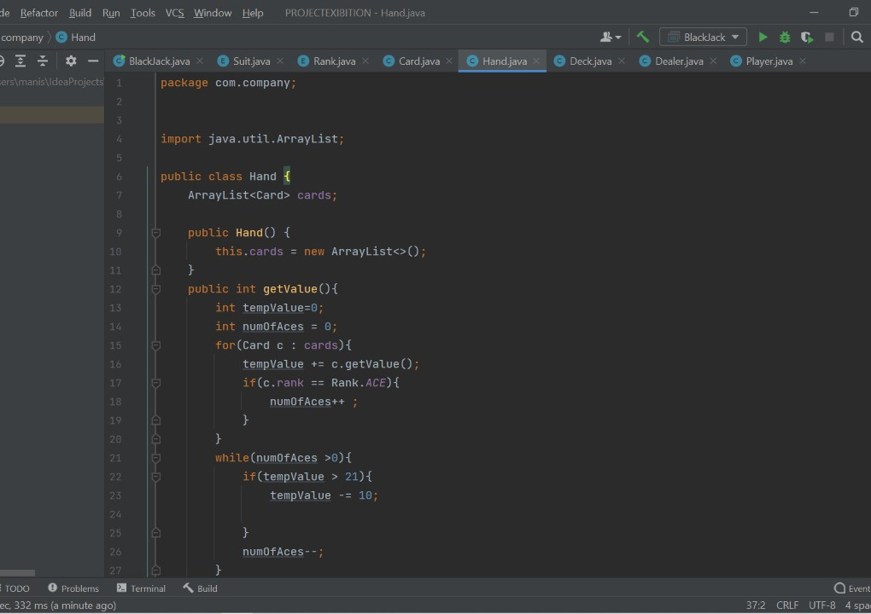
DEMO

Slide 15
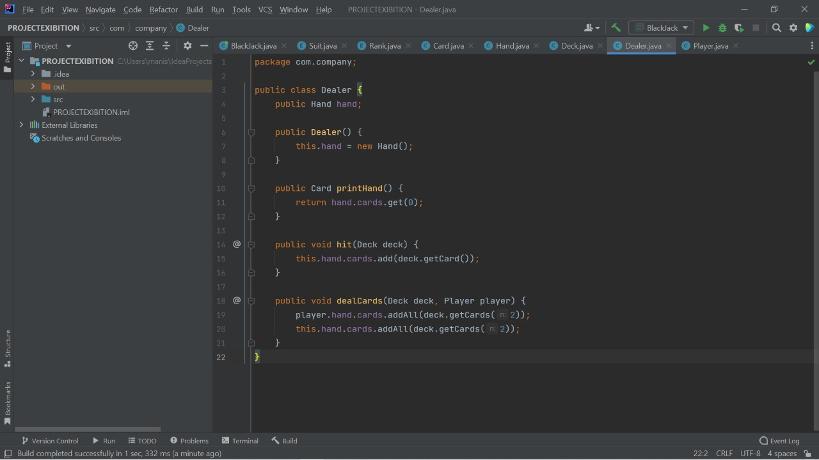
DEMO

Slide 16
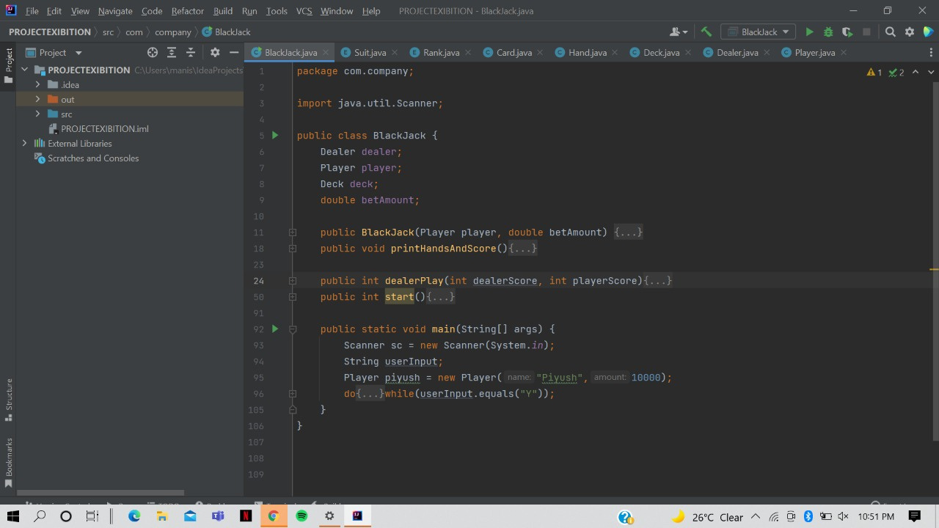
DEMO

Slide 17
implementation

Slide 18
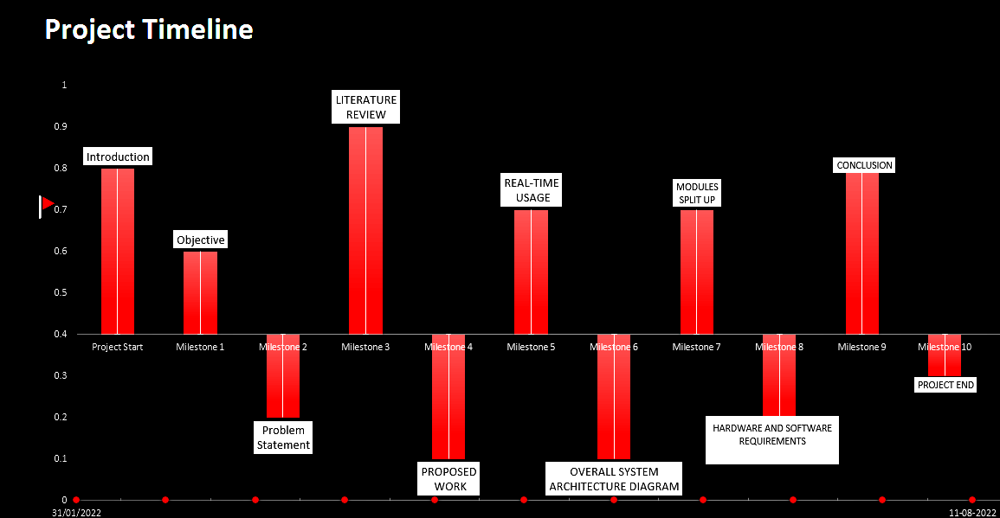

TIMELINE CHART

Slide 19
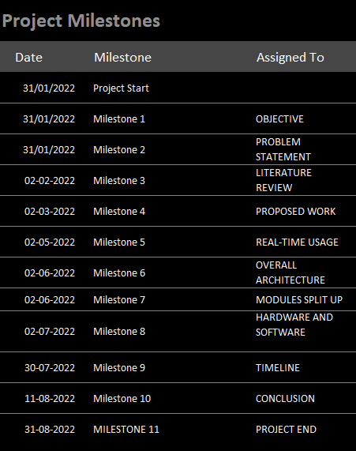
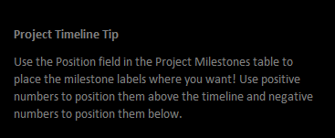

TIMELINE CHART

Slide 20
REFERENCES
https://www.youtube.com/watch?v=iP1dPQavD6Q
https://u.osu.edu/fe1181au17sec6699o/final-pseudocode/
.https://towardsdatascience.com/lets-play-blackjack-with-python-913ec66c732f
.https://bicyclecards.com/how-to-play/blackjack/

Slide 21
WHY TERMINAL BASED PROJECT?
TERMINAL BASED GAMES ARE VERY LESS AVALIBLE FOR PLAYING
AS TERMINAL ARE LESS ATTRACTIVE AND ORDINARY IN LOOK SO THIS WILL PREVENT PERSON FROM GETTING ADDICTED TO IT
AS WE KNOW ALL MAJOR PROJECT MADE ON DIFFERENT PLATFORM ARE TERMINAL BASED PROJECT

Slide 22

CONCLUSION
A game that is considered as a part of high profile life and on high demand is what every one whats to envolve in
their lives and giving them a virtual mode where
they can experience that game while sitting at their homes is the aim of our project.

Slide 23
Thank
you!

